Slide 1
Nightingale Rose Chart

Slide 2
What is the Nightingale Rose chart?
The Nightingale Rose chart is a circular graph that combines elements of a radar chart and a bar graph.
Nightingale Rose Charts became popular after English statistician Florence Nightingale famously used such a visualization to display data on how many soldiers died in hospitals during the Crimean War.
Also referred to as “polar area chart” or “coxcomb chart”

Slide 3
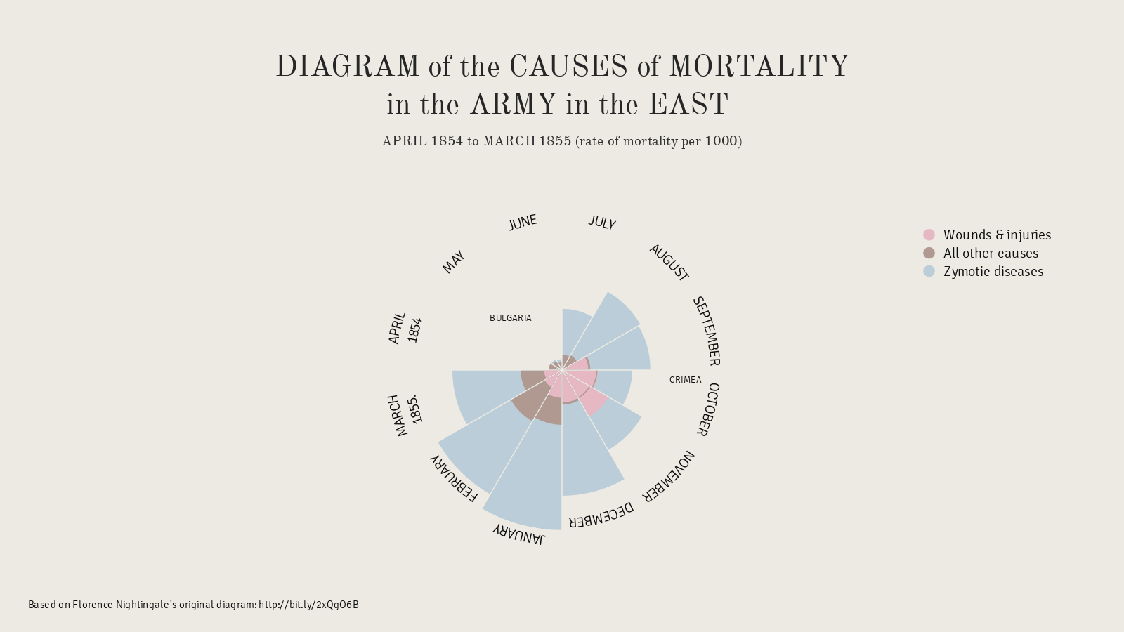
Cntd..

Slide 4
Pro & Cons
Nightingale Rose Charts work well for exploring statistical data and seasonl data.
The major flaw with Nightingale Rose Charts is that the outer segments are given more emphasis because of their larger area size.

Slide 5
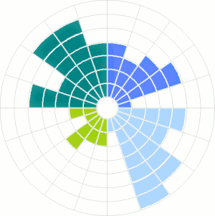
Circumplex Chart
Modified multiple bar chart
Easy to compare values

Slide 6
Tools
AmChart
Infogram
R
Excel
Tableau

Slide 7
References
https://datavizcatalogue.com/methods/nightingale_rose_chart.html
https://www.anychart.com/chartopedia/chart-type/nightingale-rose-chart/
https://excelcharts.com/the-consultants-chart-a-dilemma/

Slide 8
Thank You!

